Slide 1

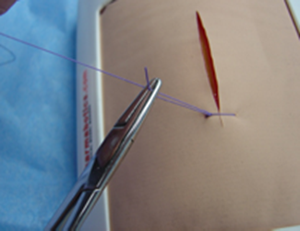
University of Basrah
College of Nursing
Fundamentals of Nursing Department
First Stage
Lecture 1
Suturing Technique
(Practice)

Slide 2
Introduction
The word suture describes any material used to approximate tissue edges together or ligate blood vessels.
The aims of closing a wound by placing sutures are to:
Eliminate any dead space
Support the wound
Allow skin edges to be accurately approximated to produce a cosmetically and functionally acceptable wound.
Prevent healing by secondary intention, which may result in an unacceptable scar
Reduce bleeding and infection.

Slide 3
Types of suture
Seq. | Trade name | Generic name
1- | Silk | Silk black braided
2- | Nylon | Nylon
3- | Vicryl | Polyglycolic acid
4- | Prolene | Polypropylene
5- | PDS | Poly-p-dioxanone

Slide 4
Classification of Suture
Generally categorized by three characteristics: –
Appearance: monofilament vs. multifilament
Absorption: absorbable vs. non-absorbable
Material: natural vs. synthetic

Slide 5
Monofilament: A single strand of material
ex. Prolene, Nylon, PDS
Multifilament: consist of several filaments or suture strands braided together
ex.Silk, Vicryl
Absorbable: Internal •Intradermal/subcuticular •Rarely on skin
ex. Vicryl, PDS
Non – absorbable: Primarily Skin –Needs to be removed later
ex. Prolene, Nylon, Silk
Natural: ex. Silk
Synthetic: ex. Prolene, Nylon, PDS, Vicryl

Slide 6
Size of Suture
- The size of suture refers to diameter of the suture material
-Numbers alone indicate progressively larger sutures ( ex : No: 2, No:1,..)
-Numbers followed by a “0” indicate progressively smaller sutures (ex: 3-0 , 4-0, …)
( No:2, No:1, 0, 1-0, 2-0, 3-0, …………….,10-0 )

Slide 7


Slide 8
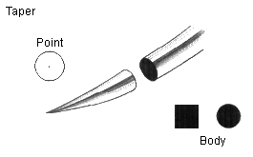
Points of Needles
1- Round needles or Tapered point needles
Characteristics : A traumatic, used for Internal organ

Slide 9
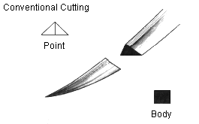
2-Cutting needles
Characteristics: Cutting edge on inside of circle, Ideal for skin, Traumatic

Slide 10
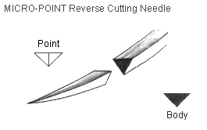
3-Reverse Cutting needles
Characteristics: Cutting edge on outside of circle, Skin, Less traumatic than cutting

Slide 11
4-Blunt point needles they have a tapered body with a rounded blunt point that does not cut tissue
-Ideal for kidney and liver

Slide 12
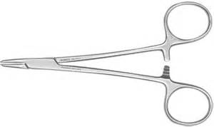
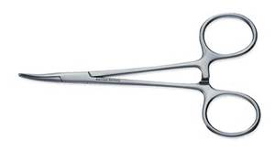
Instruments
1-Needle holder
-Straight needle holder
-Curved needle holder

Slide 13
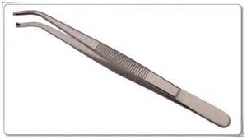
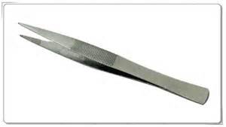
2-Pins
-Tooth
-Non-tooth

Slide 14
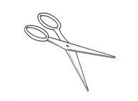
3-Scissor

Slide 15
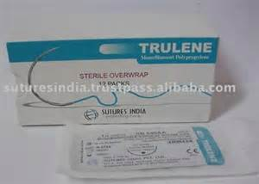
4-Suture

Slide 16
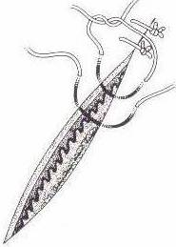
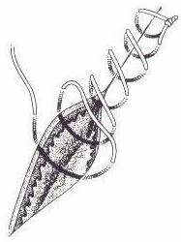
Basic suturing techniques
1-Simple sutures
-Simple interrupted sutures
This technique is usually applied to simple wounds, both traumatic and surgical
-Simple continuous sutures

Slide 17
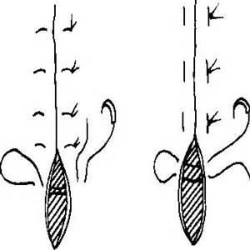
2 –Mattress sutures
-Vertical Mattress sutures
-Horizontal Mattress sutures

Slide 18
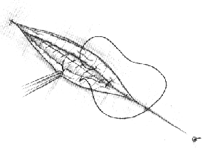
3 –Subcuticular sutures

Slide 19
Evaluate Wound for suturing
• Determine where wound location can affect cosmetic appearance or mobility.
• Arrest and control bleeding
• A facial wound is best sutured by very experienced practitioners, or medical staff due to increased risk of scarring
• Determine condition of surrounding skin (is wound jaggy/smooth).

Slide 20
Wound Cleansing
Wounds which are not grossly contaminated should be thoroughly cleansed with warm sterile solution of 0.9% sodium chloride.
Wounds that are obviously contaminated should be thoroughly irrigated, then cleaned with a broad-spectrum antiseptic solution.
The main aim of irrigation is to flush out small particles of dirt.

Slide 21
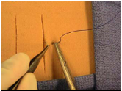
Procedure
1- Insert the needle tip into the tissue approximately 0.5 cm to 1 cm from the wound edge making sure to begin with the needle perpendicular to the tissue surface.

Slide 22
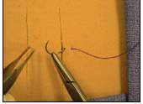
2- Supinate the wrist clockwise 90 degrees to facilitate needle passage through tissue.

Slide 23
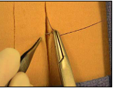
3- Grasp the needle within the wound, secure the needle, regrasp it with the needle holder, and rotate the wrist clockwise 90 degrees to complete needle passage through tissue

Slide 24
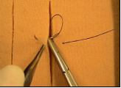
4- Insert the needle tip into the subcutaneous tissue of the opposite wound edge. Supinate the wrist clockwise 90 degrees such that the needle exits the skin 0.5 cm to 1 cm from the wound edge.
5- Secure the needle with the forceps, regrasp it with the needle holder with palms facing down and a supinate wrist, rotating the needle through the skin.

Slide 25
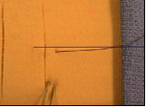
6- Secure (tie) the knot using a two-handed technique after removing the needle from the suture to approximate wound edges without undue tension

Slide 26
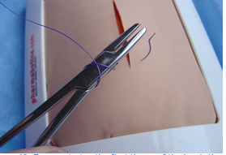
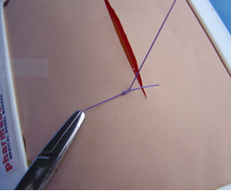
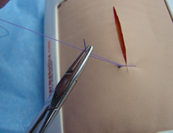
7- The knot is gently tightened, producing a square knot
8- Cut the suture, leaving a 1-cm tail on the suture.

